Slide 1
Railway Ticket Booking System
TEAMMATES: -
ARANYA CHAUHAN (RA1911028010008)
PRANIT TANDON (RA1911028010014)
KESHAV (RA1911028010021)

Slide 2
INTRODUCTION
The Railway Ticket Reservation System facilitates the passengers to enquire about the trains available on the basis of source and destination, enquire about the status of booking, etc. The aim of our project is to design and develop a database maintaining the records of available trains, passenger details mainly login credentials, and so on.
This is a computerized system of booking tickets in advance. In conventional ways passengers have to get the tickets in person. But here the passenger can book their tickets from wherever they are, making it extremely comfortable for traveling purposes. Online ticket booking has made the process for ticket booking very much easier than ever before.

Slide 3
OBJECTIVE
“Railway Ticket Booking System” is the system where the users can reserve the railway seats. This is the web browser where they can reserve it online. Designed a Railway ticket booking, reservation, and cancellation system for users that wish to travel via the Railways.

Slide 4
Methodology
Firstly, the users need to register if they are a new one on the site. They need to fill-up the form like first name, last name, age, mobile, gender, email id, password, etc. After that, they can register and get the username and password. If the user has already a username name and password they can log in to the system. They can even check their PNR status. They can book the ticket by choosing the destination and submit. Users can change the password RailwayReservation/changepw.php. For the database connection in the Railway Reservation first you need to create the database named railway.sql in the localhost/phpmyadmin/ and then you can import the database which is found railway.sql file.

Slide 5
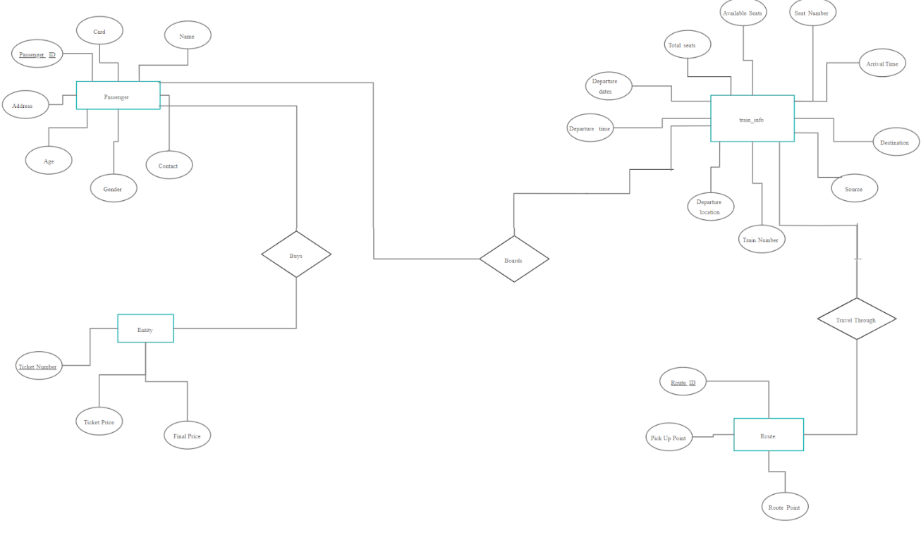
ER Diagram

Slide 6
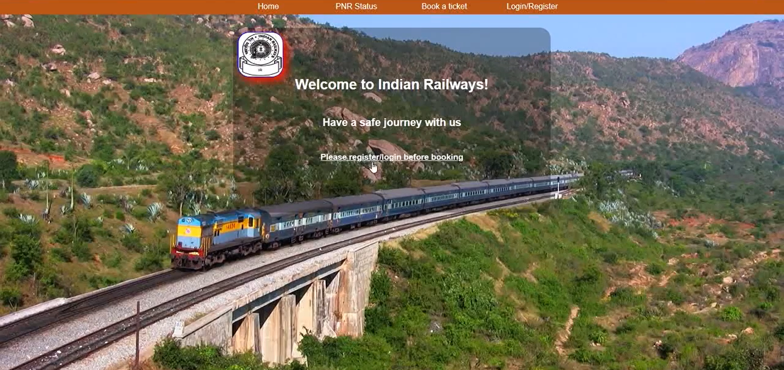
Homepage

Slide 7
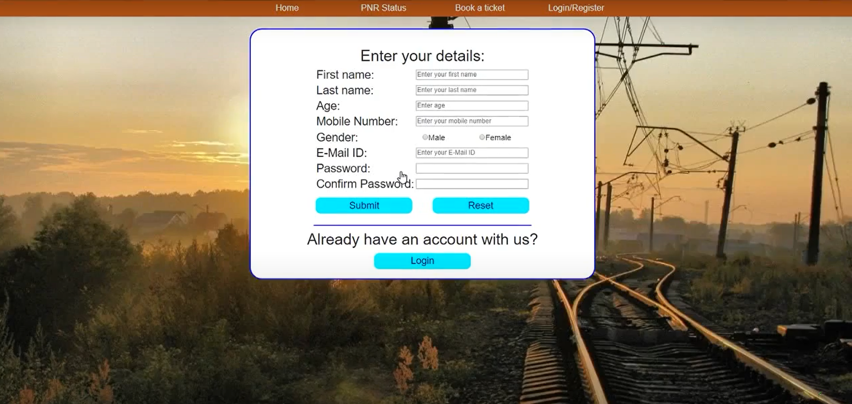
Login Page

Slide 8
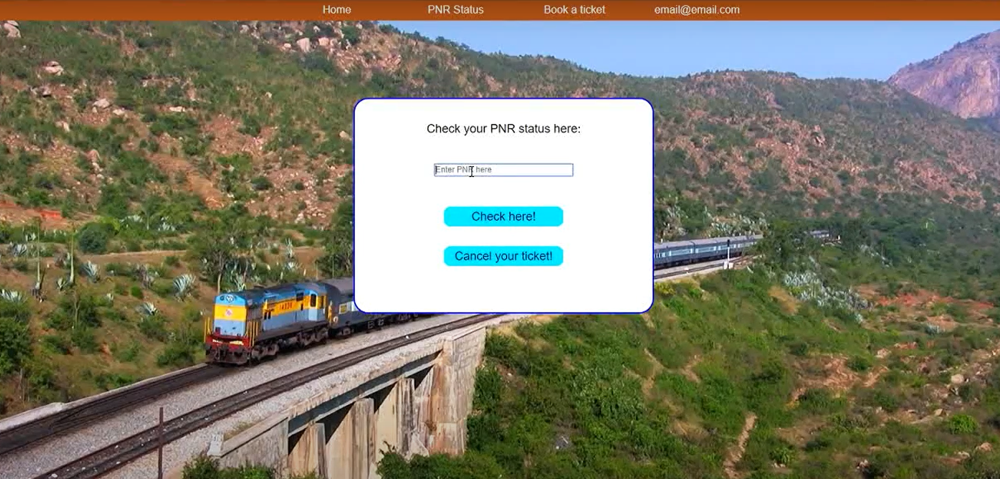
PNR Status

Slide 9
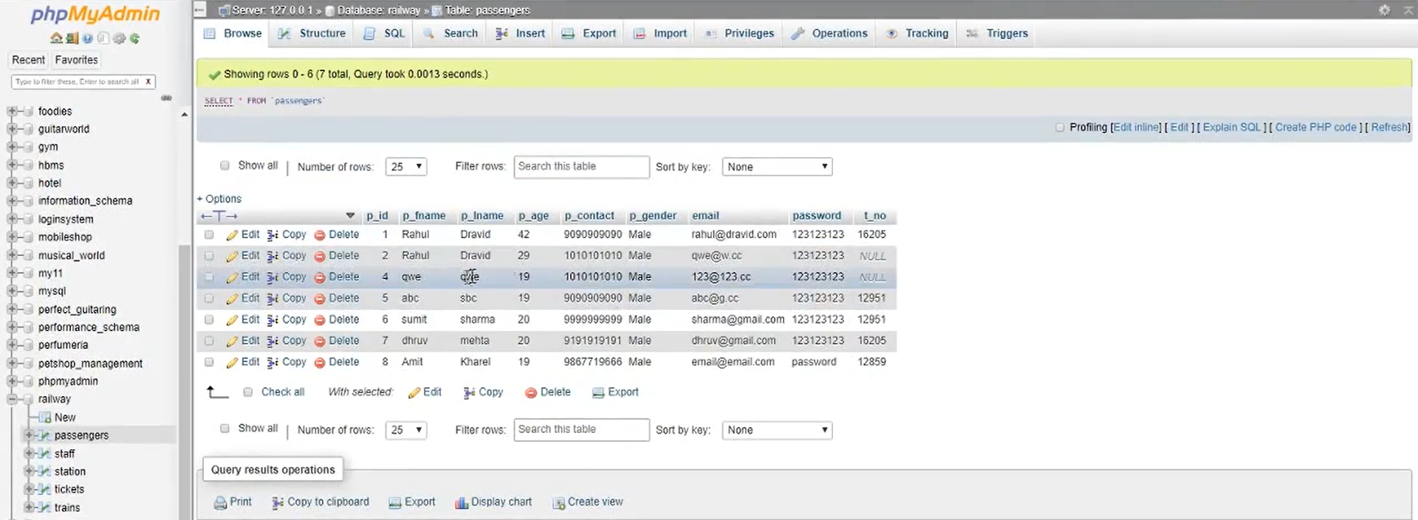
phpMyAdmin

Slide 10
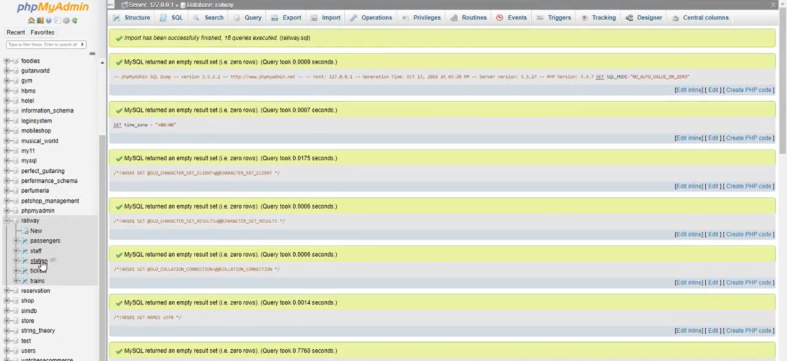
phpMyAdmin

Slide 11
THANK YOU

